Slide 1
BAIS 3300 – Sprint 3
Google Analytics Report
Kyle Lawrence
Portfolio Website: www.kylelawrence.site
Reporting Period: Nov 17 – Dec 14, 2025

Slide 2
Report Summary
I had 114 new users come to my site between November 30th and December 15th
Most visitors came to my site direct (60.12% of users), but the LinkedIn campaign proved itself to be valuable (37.5%)
Majority of visitors came from the Midwest, but had a few more foreign locations, like Prais

Slide 3
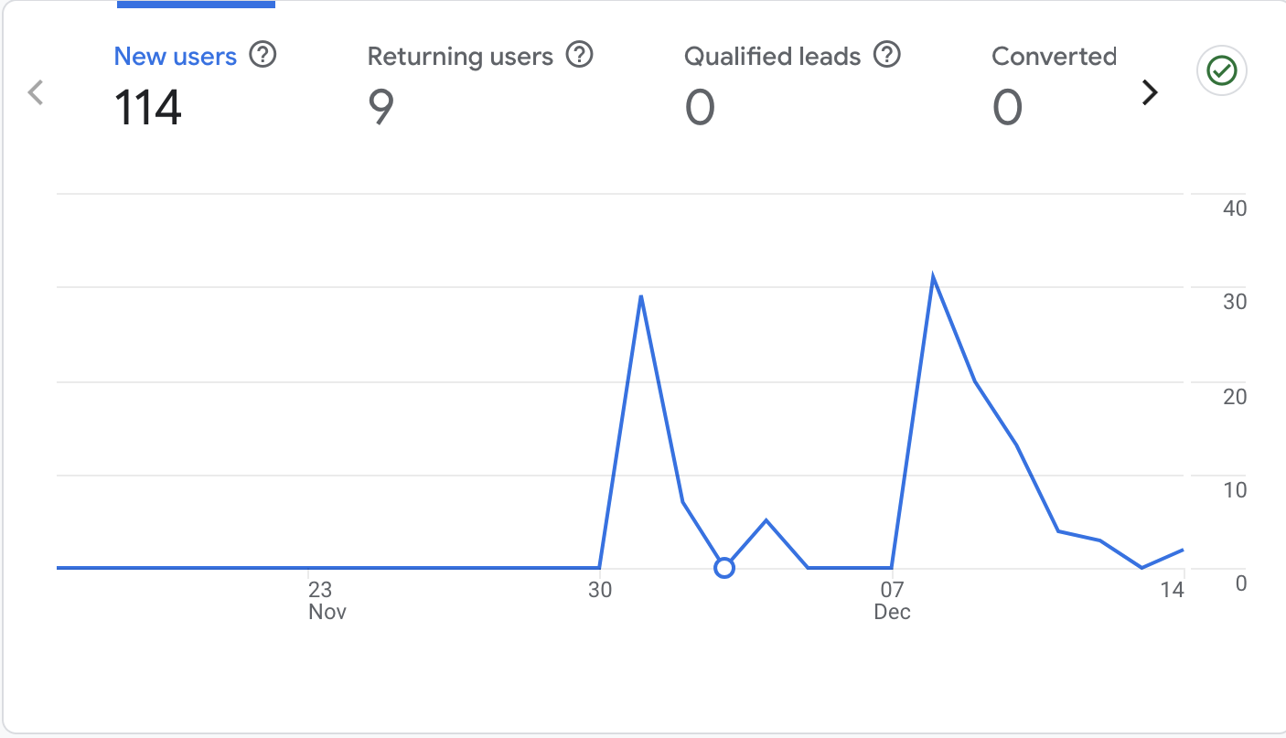
How Many Visitors Came to My Site?
Total Users: 114
New Users: 114

Slide 4
How Many Visitors Returned?
Returning Users: 9
Indicates repeat engagement with site content

Slide 5
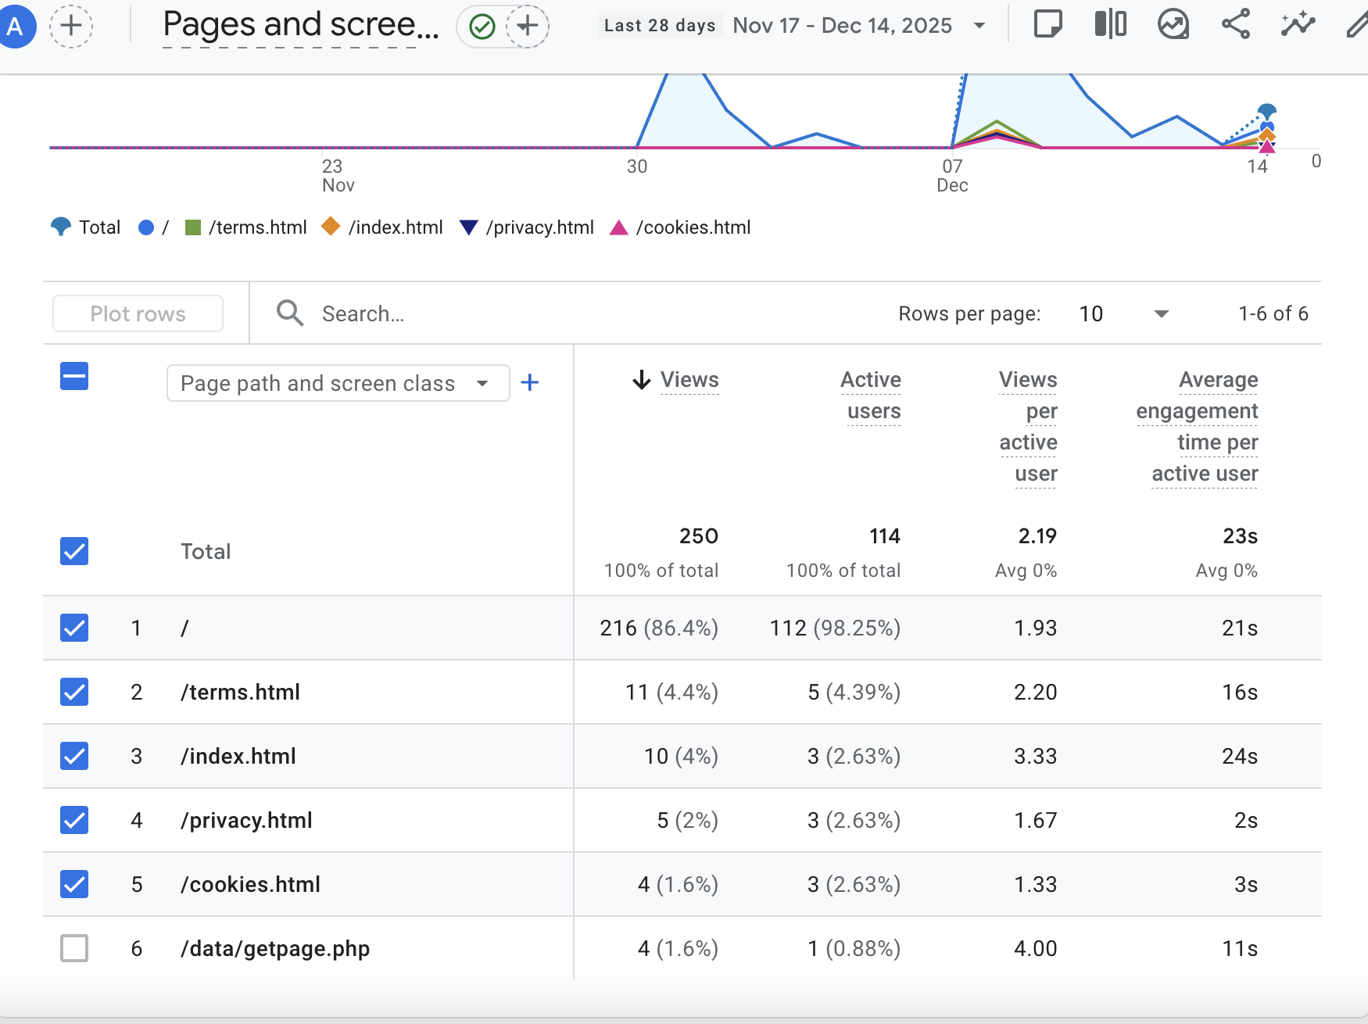
Most Popular Pages
Homepage was the most visited page
Policy pages followed (Terms, Privacy, Cookies)

Slide 6
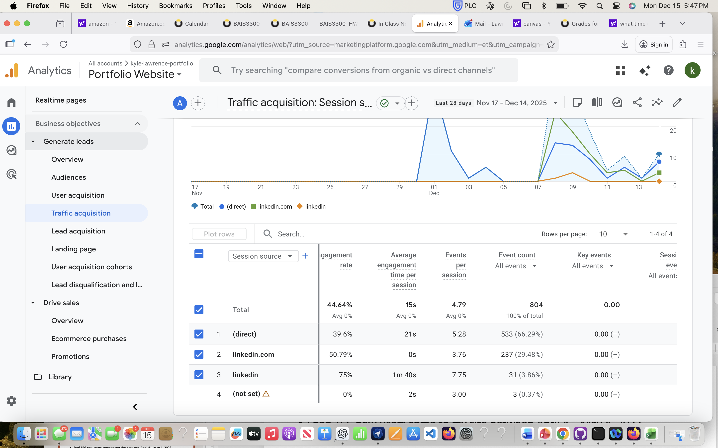
Where Are Visitors Coming From?
Majority of traffic came from Direct and LinkedIn sources
Indicates intentional sharing and promotion

Slide 7
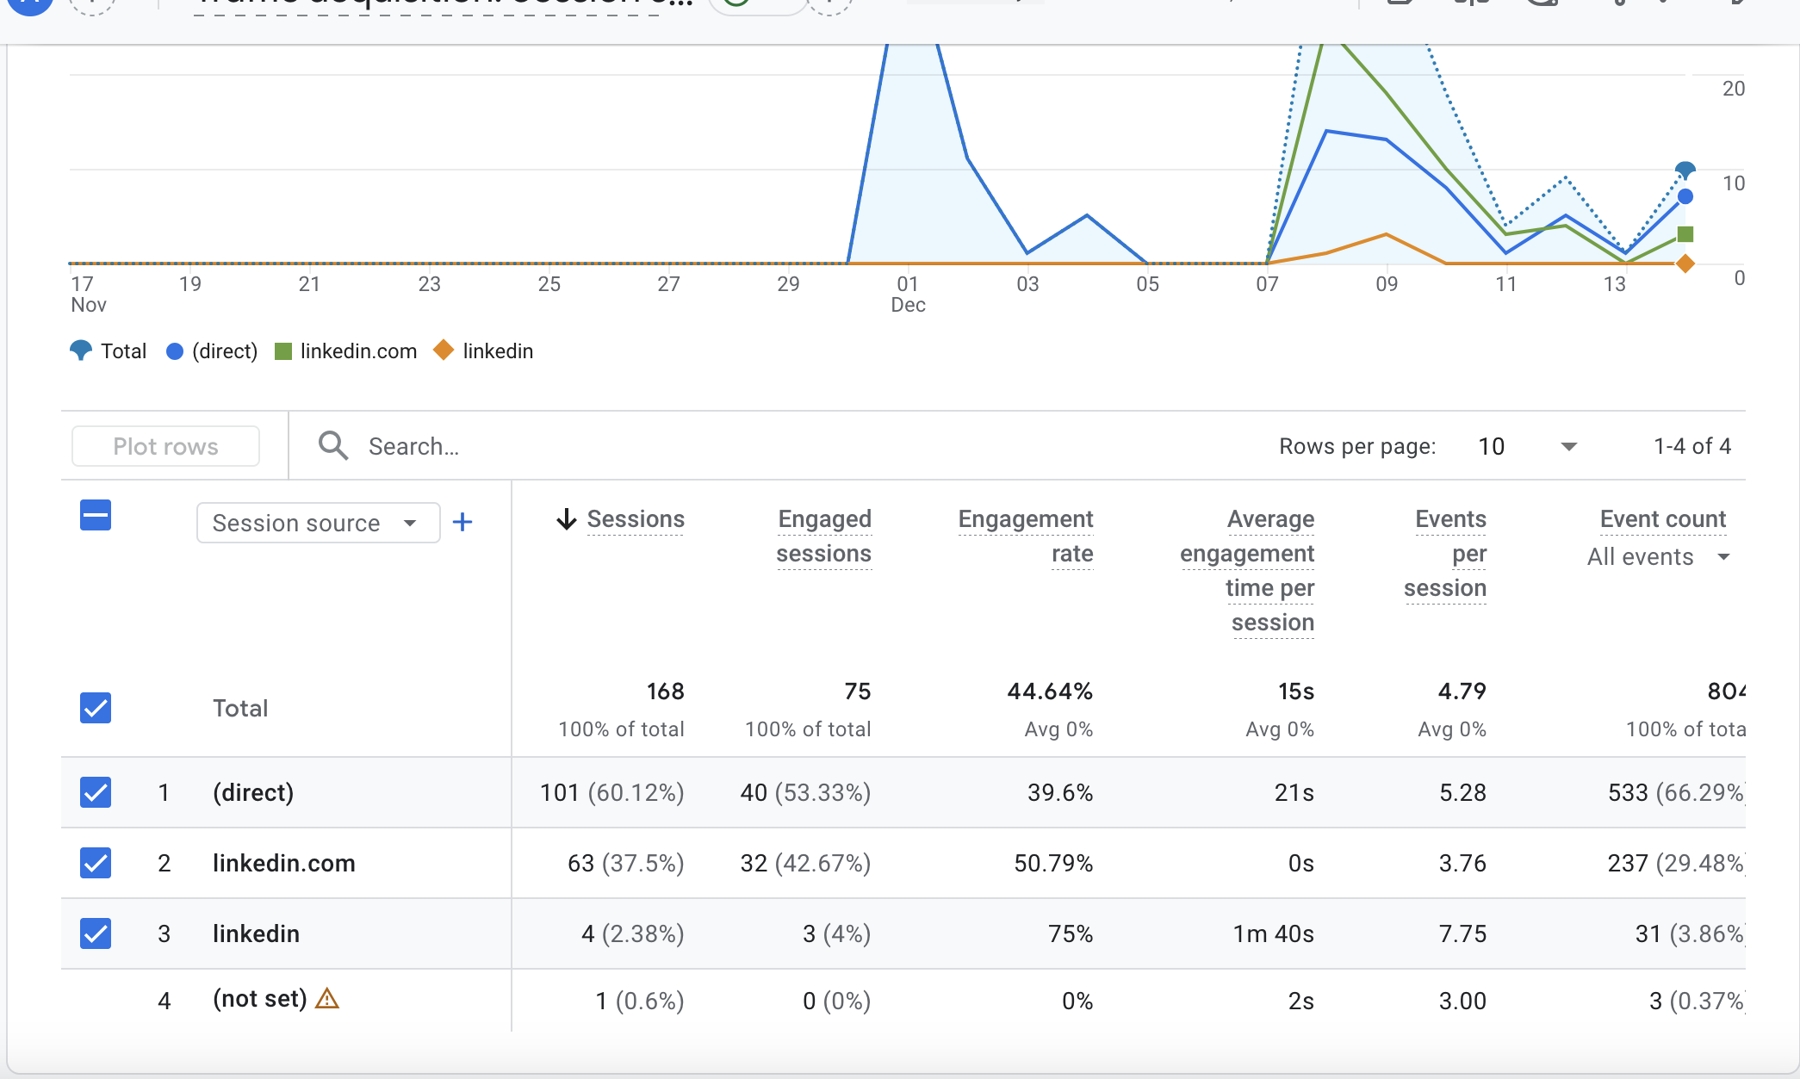
Did Campaigns Generate Traffic?
LinkedIn traffic appeared under linkedin and linkedin.com sources
Confirms campaign and social sharing effectiveness

Slide 8
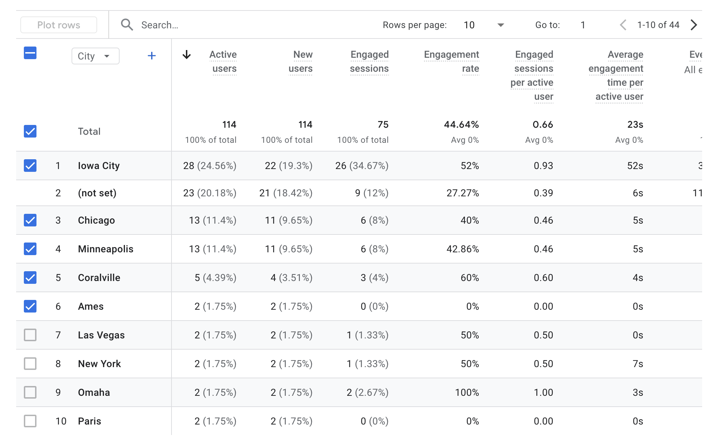
Visitor Location
Majority of users located in the Midwest
Consistent with personal and academic network

Slide 9
User Engagement
The Average engagement time varied by session source
Users actively interacted with site content

Slide 10
Conclusion
Google Analytics provided valuable insights into how users interact with my portfolio.
This data can be used to further optimize content, layout, and promotional strategies.

